Slide 1
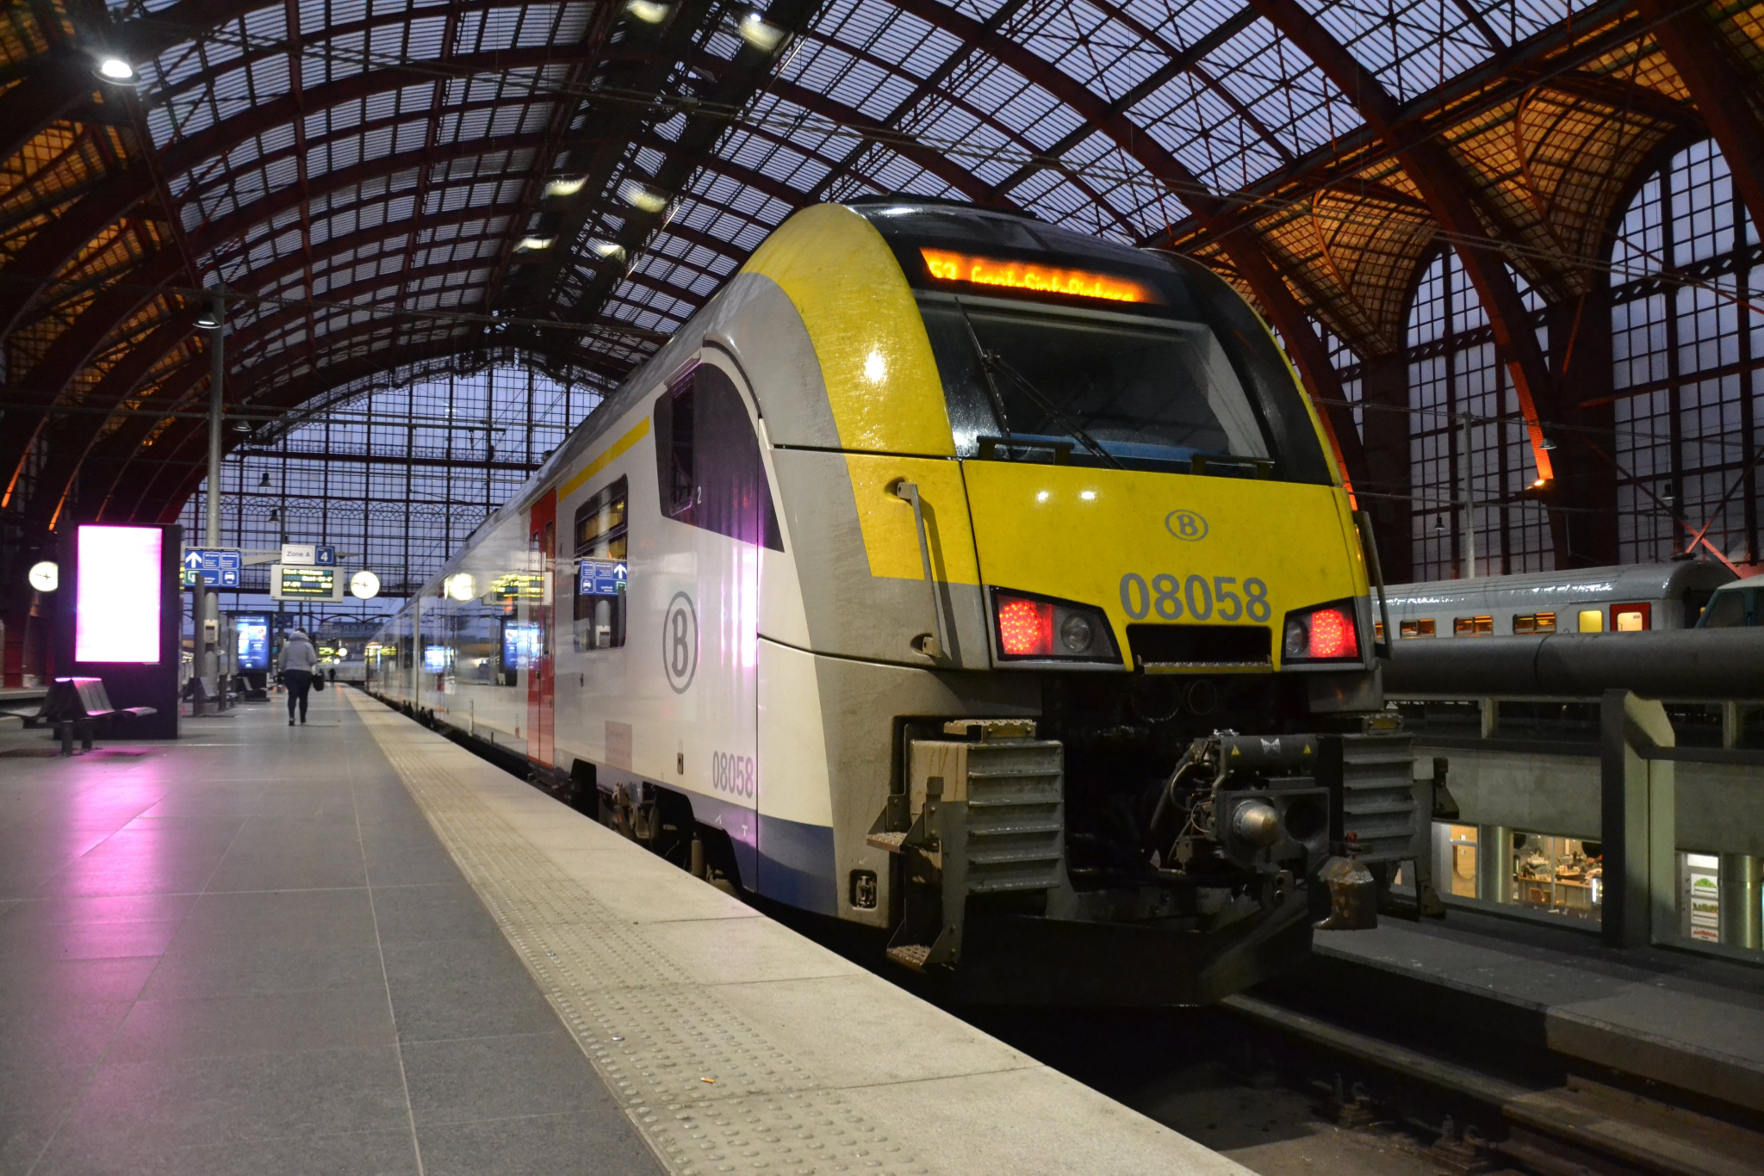
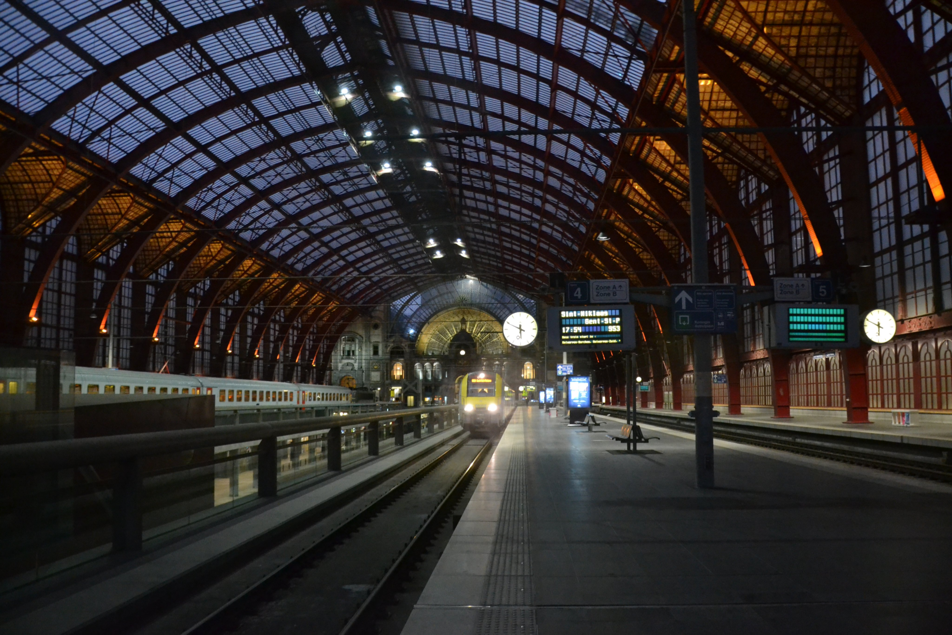

Welcome To my Presentation
Presenter : Mahnaz Ameer
Roll : 063

Slide 2
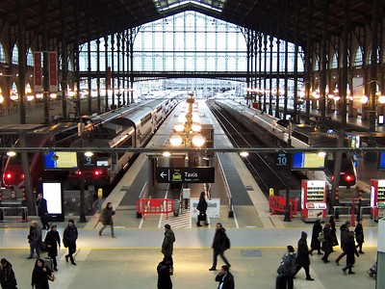
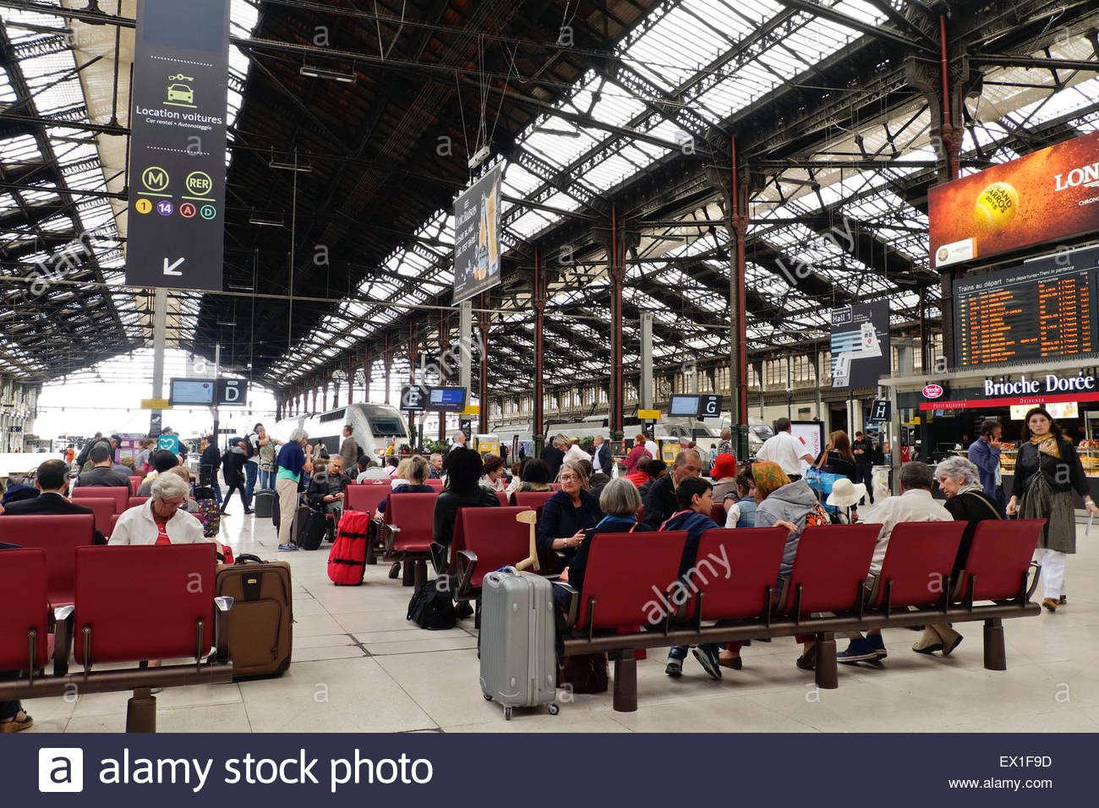
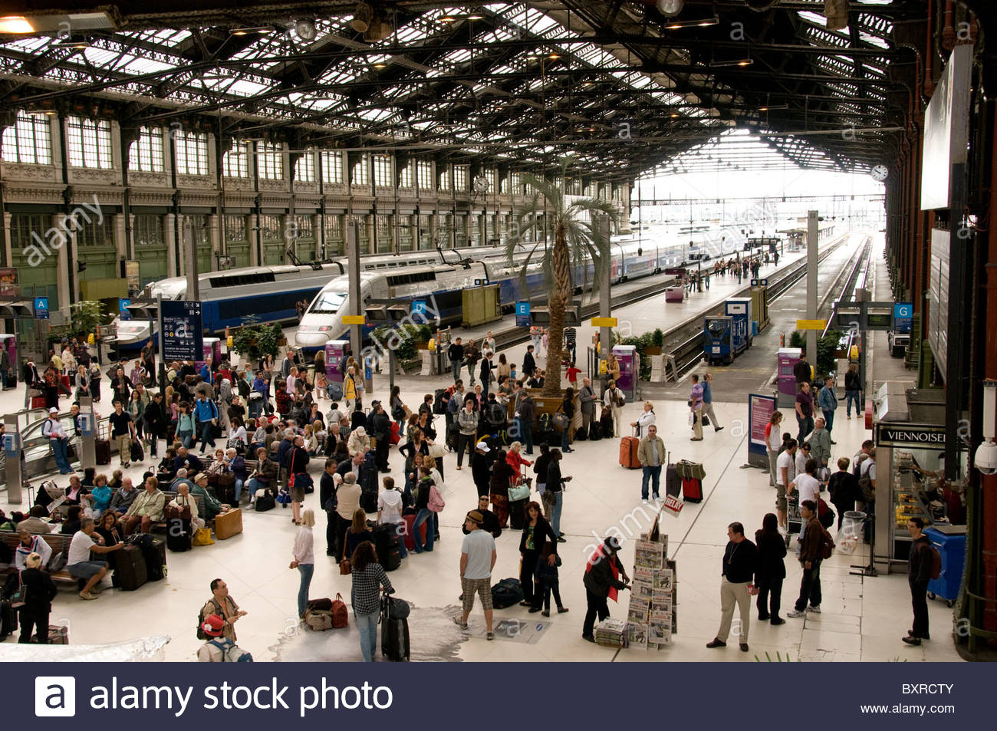
Railway Management System

Slide 3

Why I Chose This Topic?

Slide 4

Reduce the manual errors involved in booking and cancellation of tickets.
Many loopholes that exist in the manual maintenance of the records can be removed.

Slide 5

Maintaining the records of booking and traveling details.
The record of booking contains all the bookings that took place so far.
In the scheduled section, arrival and departure details of any train.
It also retrieves data of passengers and makes it available for railway authority whenever required.

Slide 6

Agent
Agent_id
Agent_name
Train
Is_Scheduled
Train_id
Train_name
Books
Has
Passenger
Gets
Booking
Has
Ticket
Station
Serail_no
Agent_id
Nid
Ticket id
Booking_status
Fare
Date
Ticket_id
seat_id
Station_id
Station_name
NId
Name
Age
Gender
State
City
Phone_no
Profession

Slide 7
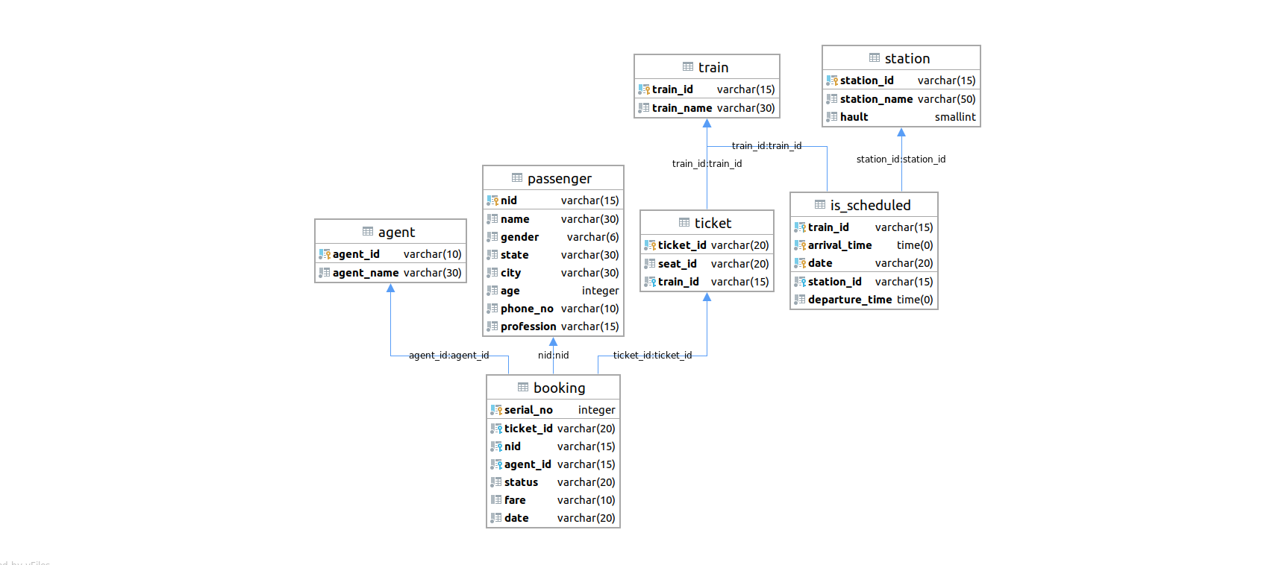
Schema Diagram

Slide 8

Schemas
Agent(Agent_id, Agent_name)
Passenger(nid,name,age,gender,state,city, phone_no, profession)
Ticket(Ticket_id,seat_id)
Train(Train_id, Train_name)
Station(Station_id,Station_name)
Booking(Serail_no,Ticket_id,Train_no,nid,Agent_id,fare,date)
Is_sheduled(Arrival_time,Train_no,Date,Departure_time,Station_id)

Slide 9

Type of queries that can be done on this database
Details of any agent who booked tickets using train id.
Details of any passenger using his nid,ticket or using agent’s id.
Status of tickets whether it is confirmed or cancelled.
Arrival and departure details of any train using it’s train id.
Can implement aggregate functions and other functions also.

Slide 10


Functional Dependencies
1 . For Schema Agent
→ agent_id -> agent_name;
→ This is in BCNF because agent_id is a super key
2. For Schema Passenger
→ nid->(name,gender,state,city,age,phone_no,profession)
→ This is in BCNF because nid is a super key
3. For Schema Train
train_id -> train_name ;
This is in BCNF because train_id is a super key
4. For Schema Ticket
ticket_id -> seat_id,train_id ;
This is in BCNF because ticket_id is a super key

Slide 11
Functional dependencies
5 . For Schema Station
→ station_id -> Stadium_name;
→ This is in BCNF because Stadium_id is a super key
6. For Schema Booking
→ Serial_no -> (ticket_id,nid,agent_id,Status,fare,date) ;
→ ticket_id -> (serial_no,nid,agent_id,Status,fare,date) ;
→ nid -> (ticket_id,Serial_no,agent_id,Status,fare,date) ;
→ agent_id -> (ticket_id,serial_no,agent_id,Status,fare,date) ;
→ This is in BCNF because Serial_no,ticket_id,nid,agent_id are super keys
7. For Schema Is_scheduled
→train_id,arrival_time,date -> station_id,departure_time ;
This is in BCNF because (train_id,arrival_time,date) is a super key

Slide 12


All of the above relation are in BCNF. Since, the LHS is a super key and there is no other non-trivial functional dependencies where the LHS is not a super key

Slide 13

Designed a good database model
Can create and manage tables
Can use different queries to retrieve data from interconnected tables/schemas
Able to reduce data redundancy by normalizing the schemas
Capable of forming first-rate database design

Slide 14
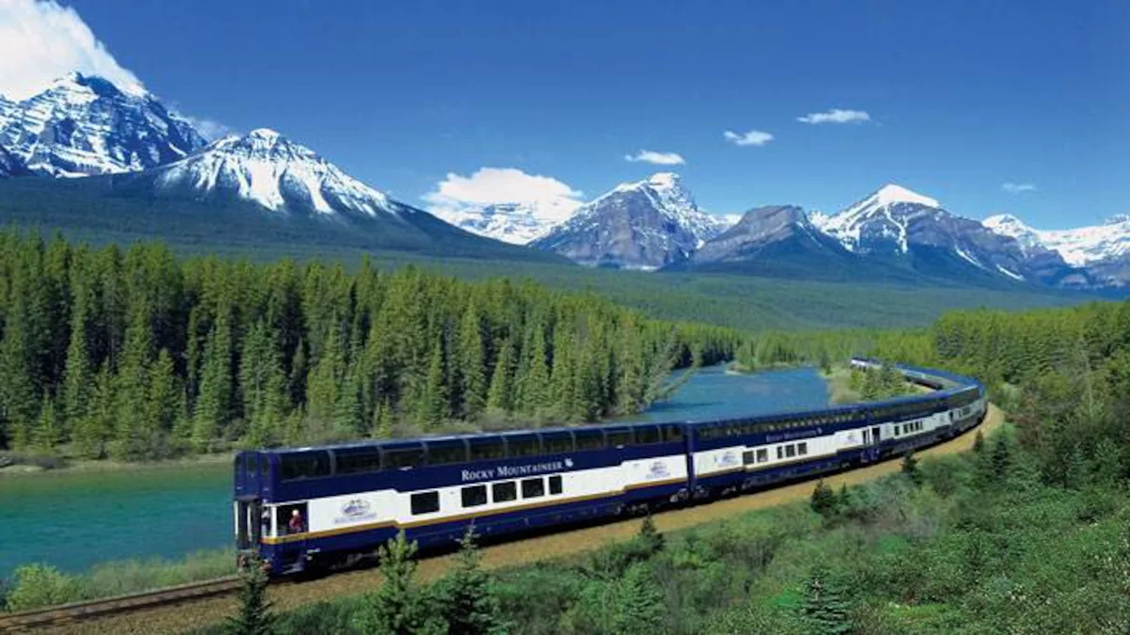
Thank you !

Slide 15


Slide 16
Agent
Agent_id
Agent_name
Train
Is_Scheduled
Train_id
Train_name
Books
Has
Passenger
Gets
Booking
Has
Ticket
Station
Serail_no
Booking_status
Fare
Date
Ticket_id
seat_id
Station_id
Station_name
NId
Name
Age
Gender
State
City
Phone_no
Profession

Slide 17
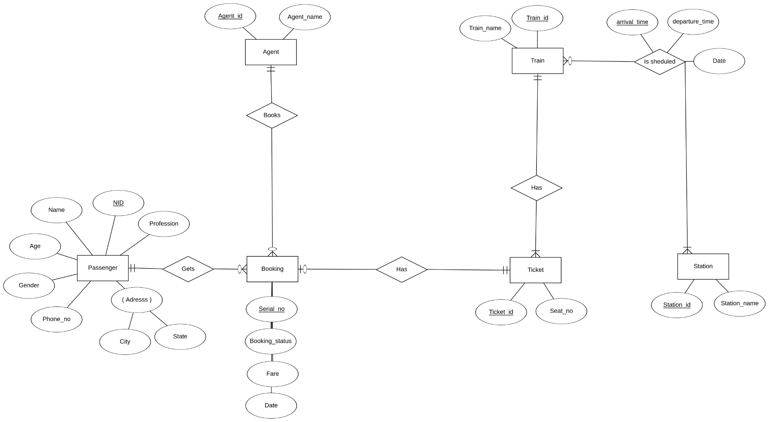
Entity Relationship (ER) Diagram

